Slide 1
“Black Arts” Index Maintenance #1.2
GUIDs v.s. Fragmentation
They're not the problem... WE ARE!
By Jeff Moden
https://eightkb.online/
28 July 2021

Slide 2
“Black Arts” Index Maintenance #1.2
GUIDs v.s. Fragmentation
They're not the problem... WE ARE!
By Jeff Moden
https://eightkb.online/
28 July 2021

Slide 3

Your Speaker – Jeff Moden
JBModen@gmail.com
Started out as an “Accidental DBA”.
Mostly Self Taught.
23 years experience working with SQL Server.
Leading Poster on SQLServerCentral.com.
Member since 2003.
More than 53,000 posts (heh… some are even useful).
39 articles on the “Black Arts” of T-SQL.
Coined the term "RBAR" (Row By Agonizing Row).
Helped make the "Tally Table" a household name.
9 Year SQL Server MVP Veteran.
Winner of the Red Gate “Exceptional DBA” award for 2011.
Frequent speaker at PASS Chapters and SQL Saturdays. (RIP)
Lead Application and part-time Systems DBA, Data Architect, and SQL Mentor for Proctor Financial, Inc.
SQL Server is both my profession and my hobby.
(Yeah, I know… I need to get a life but I have a face for radio)
It IS pronounced as “ree-bar”, like the metal rods hopelessly stuck in cement and not going anywhere fast.
Generally refers to procedural code, which is usually much slower than set-based code.
A special table to replace many types of while loops. It has a single column of incremental numbers usually starting at 0 or 1 and ending at some generally useful high-enough number.
Article at
https://www.sqlservercentral.com/articles/the-numbers-or-tally-table-what-it-is-and-how-it-replaces-a-loop-1

Slide 4
Questions…
I promise you won’t be disappointed…
Please Hold All
Questions
Until the End
Reference the page number

Slide 5
The MYTH of GUID FRAGMENTATION

Slide 6
Word Association Test…
GUID
What is your first thought when I say the word…
GUID
Did you think of things like …
All the incredible uses it offers?
The incredible Insert performance due to no “hot-spot”?
The ability to merge multiple sources with no collisions?
The ability to easily absorb “ExpAnsive Updates”?
Or…
… Did you think of what most people think of?

Slide 7
What Most People Think of First…
Why do we think this?
Because there are hundreds of demonstrations that supposedly “prove” it.
They all look something like this…
MASSIVE
FRAGMENTATION!

Slide 8
Typical Fragmentation “Problem” Demo Code
GUID Demo Code
IDENTITY Demo Code
DROP TABLE IF EXISTS dbo.BadGUID;
CREATE TABLE dbo.BadGUID
(
SomeGuid UNIQUEIDENTIFIER DEFAULT NEWID()
,PRIMARY KEY CLUSTERED (SomeGuid)
)
;
SET NOCOUNT ON;
DECLARE @Counter INT = 1
;
WHILE @Counter <= 100000
BEGIN
INSERT INTO dbo.BadGUID DEFAULT VALUES
;
SELECT @Counter += 1
;
END
;
GO
DROP TABLE IF EXISTS dbo.GoodInt;
CREATE TABLE dbo.GoodInt
(
SomeInt INT IDENTITY(1,1)
,PRIMARY KEY CLUSTERED (SomeInt)
)
;
SET NOCOUNT ON;
DECLARE @Counter INT = 1
;
WHILE @Counter <= 100000
BEGIN
INSERT INTO dbo.GoodInt DEFAULT VALUES
;
SELECT @Counter += 1
;
END
;
GO

Slide 9
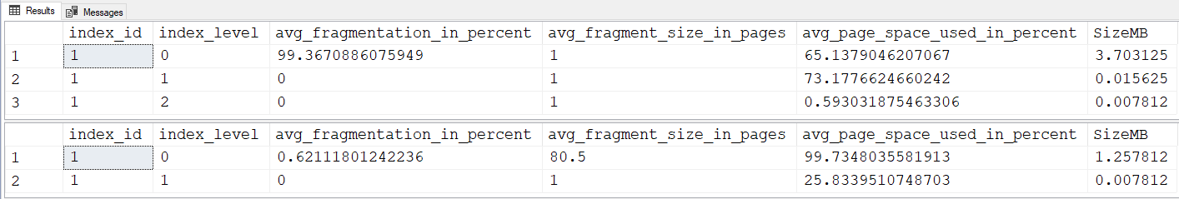
Typical Results
Check GUID Fragmentation
Check IDENTITY Fragmentation
SELECT index_id
,index_level
,avg_fragmentation_in_percent
,avg_fragment_size_in_pages
,avg_page_space_used_in_percent
,SizeMB = page_count/128.0
FROM sys.dm_db_index_physical_stats
(DB_ID(),OBJECT_ID('dbo.BadGUID'),NULL,NULL,'DETAILED')
;
SELECT index_id
,index_level
,avg_fragmentation_in_percent
,avg_fragment_size_in_pages
,avg_page_space_used_in_percent
,SizeMB = page_count/128.0
FROM sys.dm_db_index_physical_stats
(DB_ID(),OBJECT_ID('dbo.GoodINT'),NULL,NULL,'DETAILED')
;
Actually, you already know! Partially filled pages continue to be filled.
It’s the way all indexes work!
That should be a strong hint that there’s something wrong with this test but…
no one looks at it that way.
Comparisons that “prove” GUIDs are BAD
Why isn’t this at 50% or less?
If GUIDs are so bad…
GUID
INT

Slide 10
Critical Thinking
What’s missing from that test?
Reality. It’s NOT like real life.
Single highly RBAR batch on empty table.
No Index Maintenance.
Size. Neither test even qualifies for Index Maintenance. Both tests < 1000 pages (474/161)
No mention that other types of indexes suffer the same fate. For example…
Phone number
Zip Code
Names
Hash-Codes
Etc. Etc.

Slide 11
Myth Continued by “Misinformation”
What would “Best Practice” Index Maintenance do?
Everything Expected, Right?
It will reduce fragmentation to well below 1%.
The GUID index will very quickly fragment again.
We all “KNOW” this! RIGHT?
How is that “Misinformation”?
Because they never correctly identify the true cause!
What is the true cause of the fragmentation?
It’s totally US and we’re going to see why that is!

Slide 12
Session Objectives

Slide 13
Not for Rank Beginners
We’ve got a 60 minute time constraint…
Can’t cover it all about GUIDs and SQL Server so…
I have to assume that you already know a fair bit about…
GUIDs
Indexes
Index Maintenance
SQL Server in general
Log Files
Recovery Models
Etc.

Slide 14
3 Primary Objectives in this session…
1. Destroy the Myth of GUID Fragmentation.
“Poster child” for fragmentation.
Insert Millions of rows into GUID CI with…
<1% Fragmentation
No Index Maintenance for MONTHS!
2. Lay Waste to “Best Practice” Index Maintenance
Prove it’s NOT a “Best Practice”.
Prove it was never meant to be a “Best Practice”.
Demonstrate the incredible damage it causes.
Why?
Because it’s what makes GUIDs fragment!
3. Learn a MUCH better way!

Slide 15
Agenda (More Things!)
Demonstrate the simple fix for GUID fragmentation.
Bust Index Maintenance Log File Myths
Reorganize is NOT your friend.
Why NEWSEQUENTIALID() might not be the fix.
Introduce “ExpAnsive Updates”
“Ever-Increasing” & NewSequentialID() indexes die here.
Random GUIDS prevent fragmentation here!
Tons of ancillary information
Including a new tool to actually see an index. (Included in ZIP file)

Slide 16
IDENTITY v.s. Random GUIDs
Quick Review

Slide 17

Why People Think Random GUIDs Are Bad!
Ever Increasing Index.
For Inserts, only the last pages
will be in memory.
No “Bad” Page-Splits.
NO FRAGMENTATION.
NO INDEX MAINTENANCE!
All Pages “Naturally” Filled to 100%
All Pages “Naturally” Filled to 100%
“Good” Page Splits
Random GUIDs
For Inserts, possibly ALL pages
will be in memory.
If the pages are full,
then Inserts/ExpAnsive Updates will cause
massive “Bad” Page-Splits
and Fragmentation.
Instant doubling of space used.
Start Thinking…
What would make these pages FULL?
COULD INDEX MAINTENANCE MAKE THEM FULL?
WHAT HAPPENS IF WE INSERT MORE ROWS NOW?
WOULD WE GET MORE PAGE SPLITS?

Slide 18
Good Things About GUIDs
Ever Increasing Index.
“No Fragmentation” and
“No Index Maintenance”
but…
“Hot Spot” at “end” of Index.
Each session waits its turn to INSERT.
Extra wait for “good” page-splits.
WICKED SLOW OLTP CODE!
ExpAnsive Updates KILL!
IT ALL BLOCKS SELECTS!
NEWSEQUENTIALID()
HAS THE SAME PROBLEM!
“All at once” batch inserts work just as well!
Out of order INSERTs and/or “ExpAnsive Updates”
Random GUID
NO END-OF-INDEX HOT SPOT.
No waiting on INSERTs or UPDATEs.
(no contention for 1 page)
Weathers “ExpAnsive Updates”
No page-splits!
Also means,
“NO FRAGMENTATION”
As long as there’s enough room on a page,
an out of order Insert or “ExpAnsive Update”
will NOT cause a PAGE-SPLIT!
Wait! WHAT!!!???

Slide 19
The 3 Purposes of Index Maintenance
Quick Review

Slide 20
3 Things Index Maintenance Can Do
1. Fix Logical Fragmentation.
ONLY matters for sequential “Read Aheads” (Range Scans).
Frequently, doesn’t matter at all, especially for OLTP.
Usually doesn’t matter at all on SSDs.
2. Fix Physical Fragmentation.
Increase “Page Density” or “% of Page Fullness”.
Saves disk space and memory (buffer) space.
3. Prevent Page Splits.
Prevents EXCESSIVE BLOCKING!
Prevents EXCESSIVE LOG FILE USAGE!
Seriously REDUCES FRAGMENTATION!
Seriously REDUCES INDEX MAINTENANCE!
MAKES THINGS FASTER…EVEN SELECTs!!!

Slide 21
Why “Bad” Page Splits are “BAD”!
An Intro to Fragmentation

Slide 22
“Bad” Page Splits – How They Work
Occur in the logical "middle" of the index.
4 to 43 times tougher on the log file than a “good” page split.
Everything is fully logged!
And then the B-Tree is updated and logged along with frequent splits of its own (may cause blocking of many other queries).
Pages not released until transaction commits.
There's not enough room for the new row and so the transaction is extended to the next logical page.
SQL Server starts a system transaction on the page and checks it for space.
Transaction
Transaction
1
2
3
3
4
5
6
New
6 pages in Leaf Level…
Filled to capacity.
In Physical Order for now.
All pages are doubly linked to each other. Logical Order.
Logical Order = Physical Order = No Fragmentation.
The links between the two existing pages are dropped.
Finally, the new row is added in to the page.
About half the rows are moved from the target page to the new page.
SQL Server will insert a new row on a page in the correct logical order… Page 3, in this case.
Pages 3 and 3A suffer "Physical" Fragmentation because they are no longer full.
Pages 3, 3A, and 4 are all part of "Logical Fragmentation"
New links are created between the existing pages and the new page.
An existing empty page is found or a new one is created.
Empty
Page
3A

Slide 23
So… What’s the Problem with
GUID FRAGMENTATION???
We “drank the Kool-Aid” and
We keep using “Best Practices” that aren’t.

Slide 24
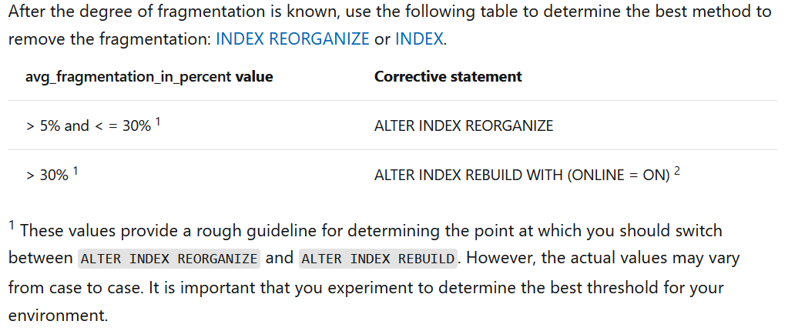
What everyone thinks is a “Best Practice”

Slide 25
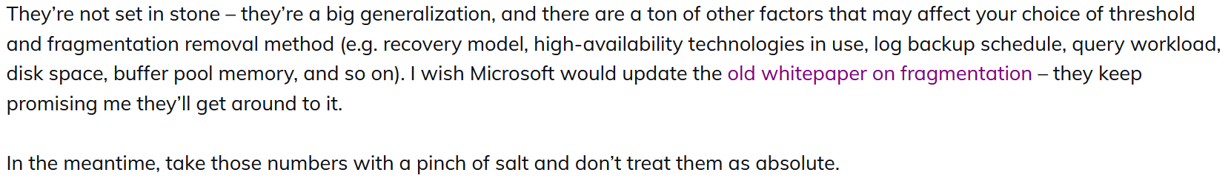
Where did those numbers come from?
https://docs.microsoft.com/en-us/sql/relational-databases/indexes/reorganize-and-rebuild-indexes?view=sql-server-ver15
Paul Randal
https://www.sqlskills.com/blogs/paul/where-do-the-books-online-index-fragmentation-thresholds-come-from/
Update on 20 April 2021…
They removed all that
from the documentation.
Don’t treat them as a
“Best Practice”!

Slide 26
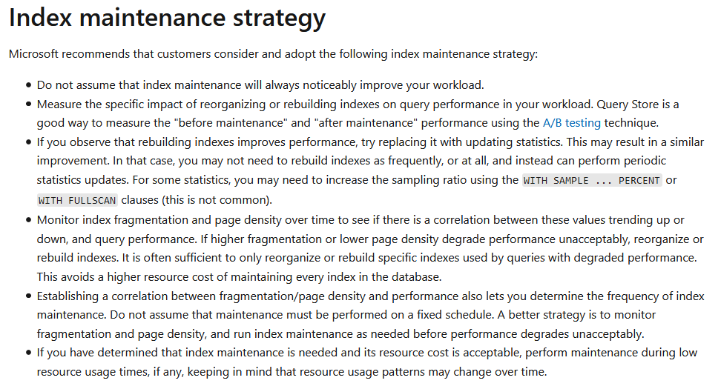
Change to Documentation on 20 April 2021
The never tell you how to
Automatically
correlate performance
to even one index never mind
for ALL Indexes!

Slide 27
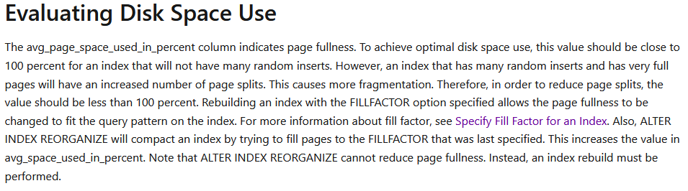
Further Proof in the MS Documentation
Almost everyone misses this…
https://docs.microsoft.com/en-us/sql/relational-databases/system-dynamic-management-views/sys-dm-db-index-physical-stats-transact-sql?view=sql-server-ver15
Great Intro to Fill Factor and Out-of-Order Inserts!
up
^

Slide 28
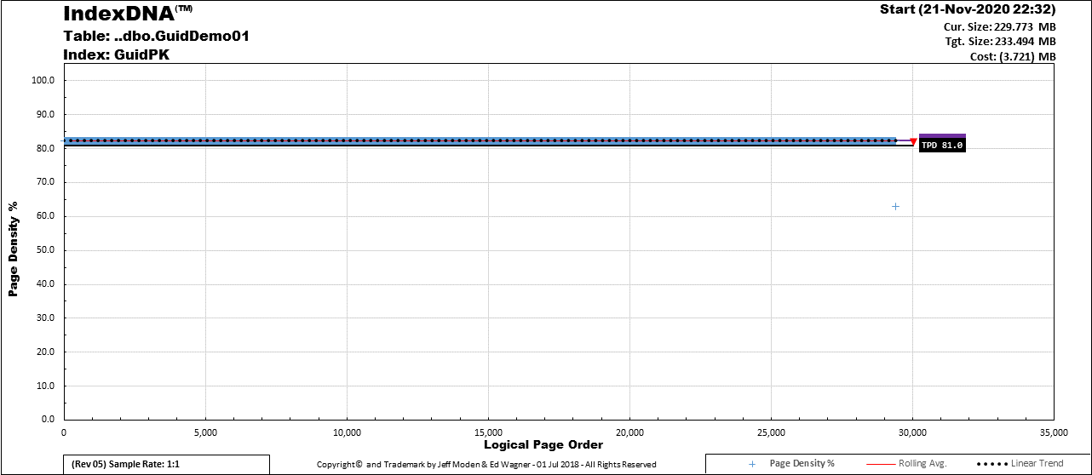
Introduction to IndexDNA™
A Page
~63% Full
Logical Page Order / Page Count.
These are NOT page numbers.
Page Density

Slide 29
Introduction to IndexDNA™
Legend

Slide 30
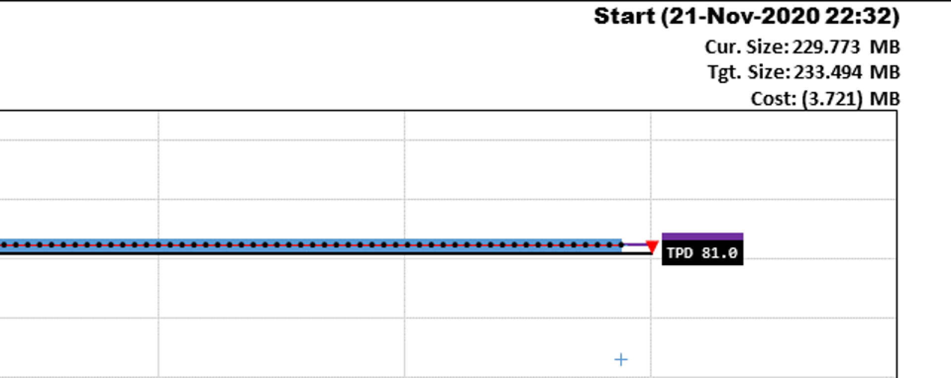
Introduction to IndexDNA™
Blue Bar is Multiple Pages Near Each Other
Single Page
(Page Density %)
Legend

Slide 31
Introduction to IndexDNA™
Skinny Red Line
Rolling Average

Slide 32
Introduction to IndexDNA™
Black Dotted Line
Linear Trend

Slide 33
Introduction to IndexDNA™
APD – Average Page Density
Purple Box and Line

Slide 34
Introduction to IndexDNA™
Cost or Savings in MB Between Current (APD) and Target (TPD) sizes
TPD – Target Page Density
Black Box and Line

Slide 35

Introduction to IndexDNA™
Table and Index Names
All the pages have the same fullness after REBUILD.
Dynamic Sample Rate

Slide 36
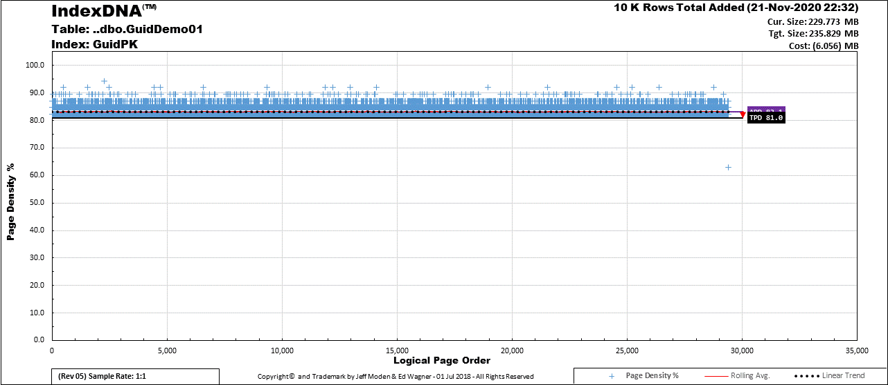
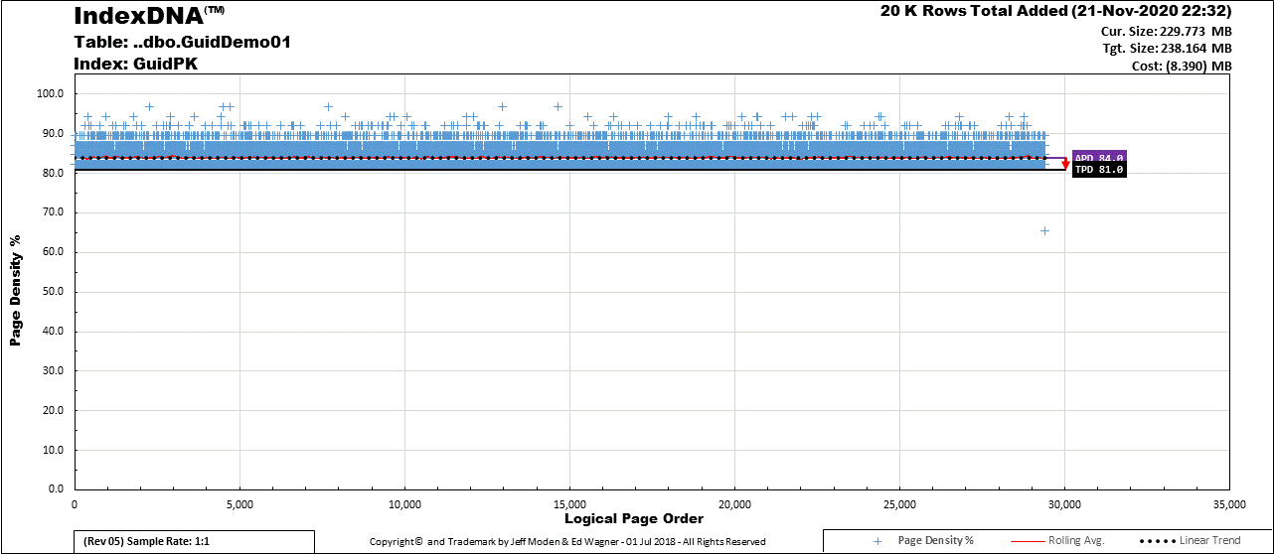
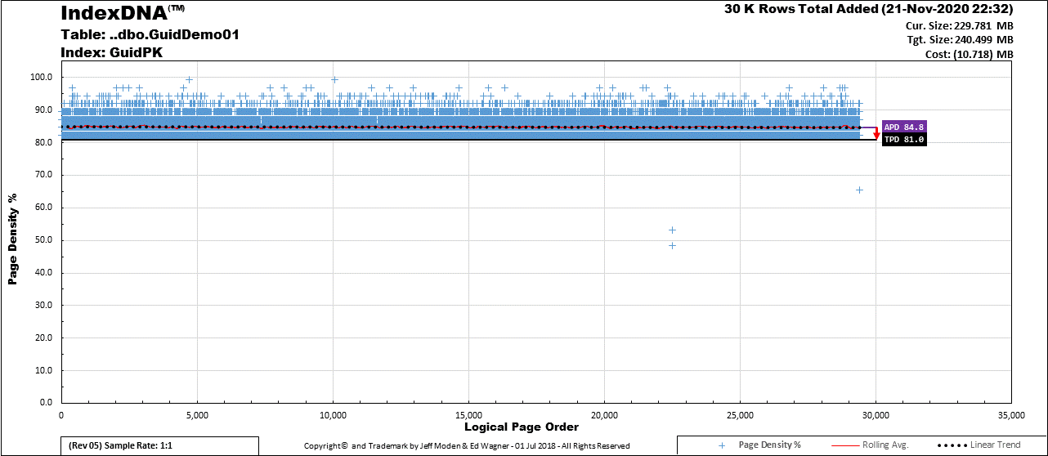
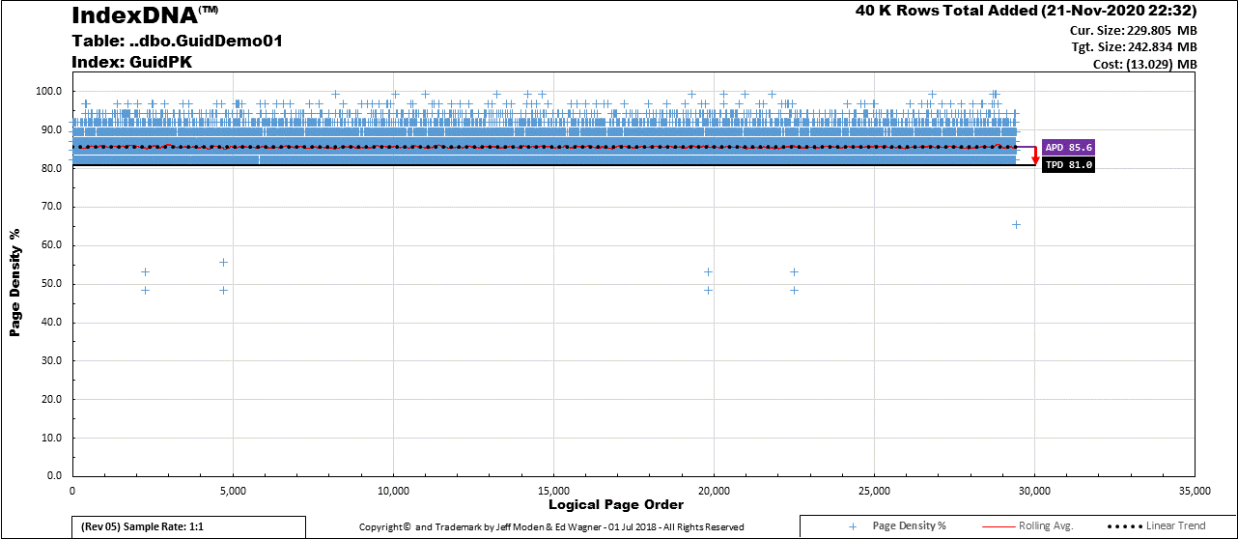

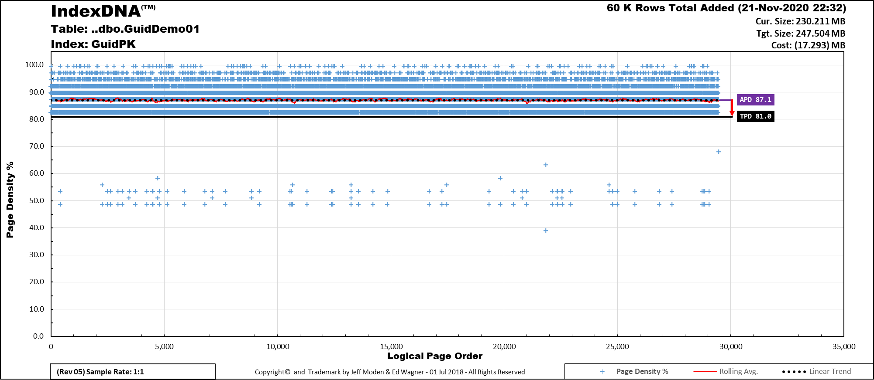
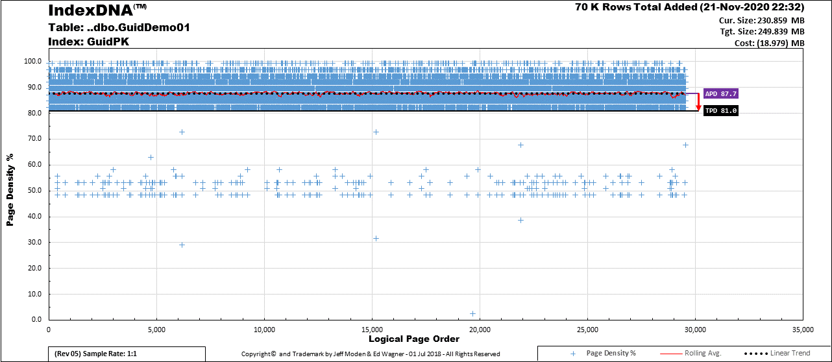
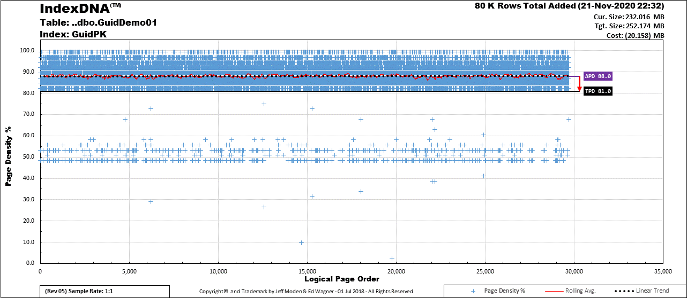
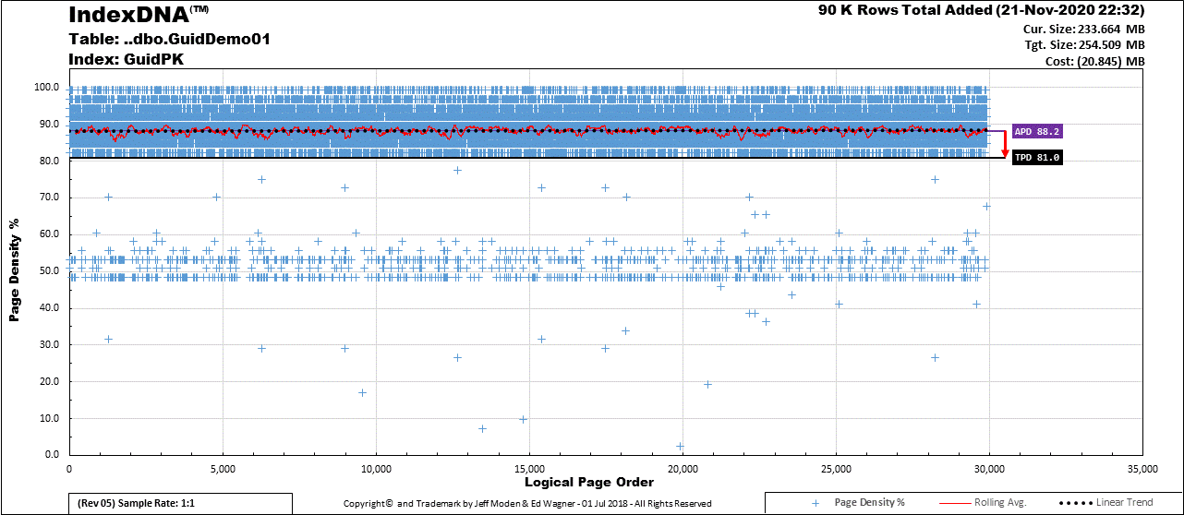

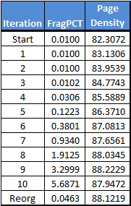
Fragmentation Study of 1 Million Row GUID 10K Rows Inserted Each Daily Iteration
Watch this area for pages filling up
Watch this area for splits

Slide 37
Critical Point Reached
“Best Practices” says it’s time to
REORGANIZE!
Oooooohhhh Yeah….
Let’s see how “well” that works!
Critical Area Above
Fill Factor is FULL!
Page Density Decreasing
Between 5 and 30% Logical Fragmentation
Serious Increase
of Page Splits

Slide 38
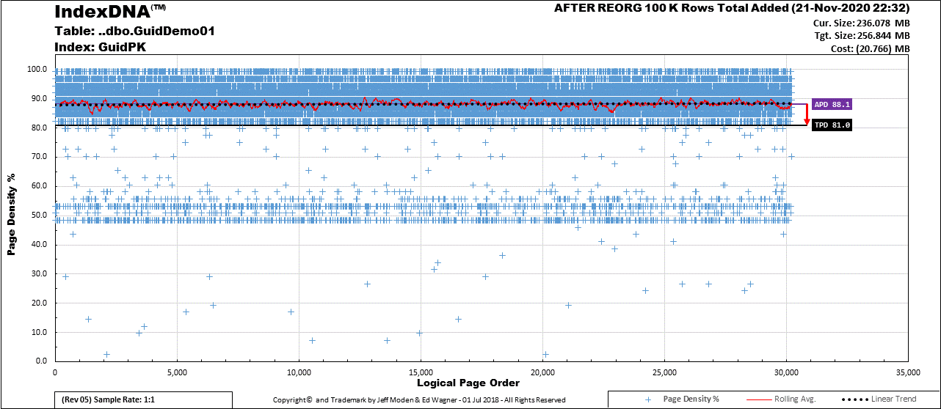
REORGANIZE – Death by Defragmentation
REORGANIZE
Removes Free Space when we need it the most!
REORGANIZE Compresses Pages
UP TO the Fill Factor!
REORGANIZE
Cannot Make New Pages!
REORGANIZE Will NOT Make Space above the Fill Factor!
Critical Area Above
Fill Factor is STILL FULL!
And actually got FULLER!
Page Density Increased BUT Should Have Decreased
Still a ton of
Low Density Pages
It fixed the Logical Fragmentation

Slide 39
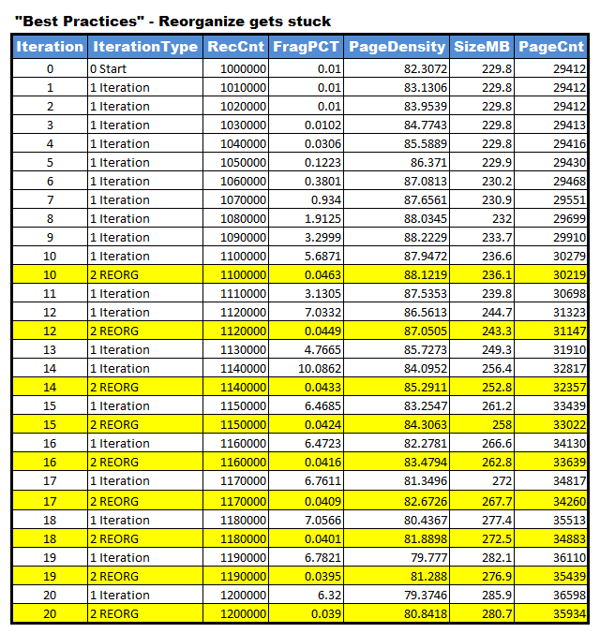
REORGANIZE v.s. “Low Threshold” REBUILDS
Instead of
waiting for
2 days of some
pretty nasty
fragmentation
Just 2 Days
7% Frag
REORGANIZE gets STUCK very quickly!
Just 2 Days
10% Frag
Just 1 Day
>6% Frag
Kind of.
Table is getting bigger so constant number of inserts
is getting proportionally smaller but, remember…
REORGANIZE ALSO REMOVES FREE-SPACE.
Fragmentation Decreasing?

Slide 40
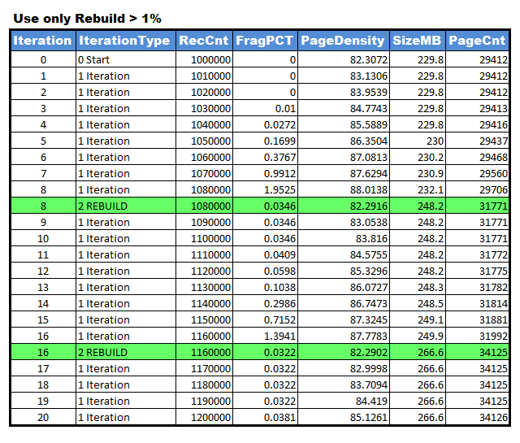
REORGANIZE v.s. “Low Threshold” REBUILDS
REBUILD
At >1%
221
8 Days
to get to >1%
fragmentation
1104
1670
1082
1
1108
1178
And REBUILD included
2 extra days!!!
1253
222 Total Page Builds
1227
REORGANIZE CAUSED 44 TIMEs
MORE PAGES THAN REBUILD!
1159
9781 Total Page Builds

Slide 41
Long Term Fragmentation Studies
“Best Practice” v.s. “Low Threshold” Rebuilds

Slide 42
Table Metadata
Test Table
GUID column – UNIQUEIDENTIFIER – Clustered PK
FLUFF column – CHAR(100) – Simulates other columns
Row Length – 123 Bytes including 7 Byte Row Header
Rows per Page – 65 (8096/123 = 65.821 = |65|)
And, yes, 8096 and not 8060 is the correct value to use for these types of index calculations.

Slide 43
Test Parameters
All Tests
Use the same 3.65 Million GUIDs from a source table for each test.
Use same random sort order (except for “Baseline”)
“Baseline” Test
GUIDs Pre-Sorted
No Page Splits (Sorted GUIDs are “Ever Increasing”)
“No Index Maintenance” Test
“Best Practice” Tests
Do nothing until > 1,000 pages
<5% – Do nothing
5% to 30% – Reorganize
> 30% – Rebuild
Fill Factors – 70, 80, 90, and 100
“Low Threshold” Rebuild Tests
Do nothing until > 1,000 pages
>1% – Rebuild (Never Reorganize)
Fill Factors – 70, 80, 90, and 100

Slide 44
Conditions – Simulation Code Flow
Start
1,000 Individual Row Inserts per Hour
10 Hours per Day
365 Days
3.65 Million Rows Total for Each Run
Day Counter
1 to 365
Hour = 00
Record Frag
& Index Maint.
& Defrag Dur
Hour Counter
1 to 10
Measure
Fragmentation
Insert 1,000 rows for hour
RBAR
Defrag?
N
Record Insert Duration
Y
Index Maintenance per
“Best Practices”
or
“Low Threshold” Rebuilds
or
“No Index Maintenance”
Index
Maintenance
Bump the Day Counter
Measure/Record
Fragmentation
Note
Defrag Dur
N
Days Done?
Bump the Hour Counter
Count Daily
Log File
Entries/Size
Y
Hours Done?
N
Y
Stop

Slide 45
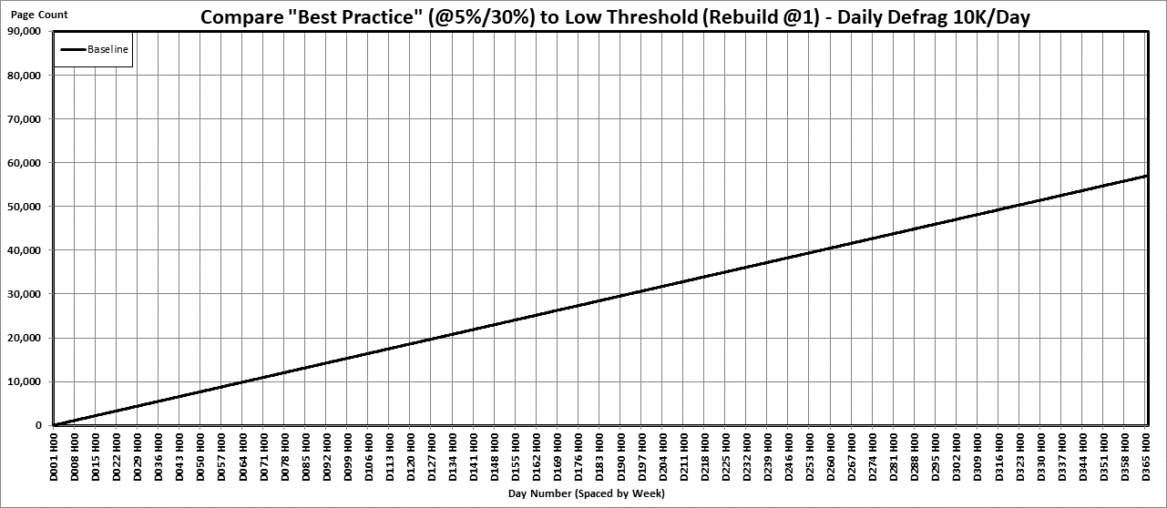
Baseline (GUIDs Inserted in Sorted Order)
Baseline Facts
Presorted “Ever Increasing”
(Like an IDENTITY Column)
Zero “Bad” Page Splits
Virtually Zero Fragmentation
Zero Index Maintenance
Baseline Facts
Except for nearly vertical lines
(which are caused by Index Mainentance)
any line with a slope steeper than the Baseline
has “Bad” page-splits that cause fragmentation.
Test Duration
1 Simulated Year
Baseline
Page Count
Of
Leaf Level
Vertical
Gridlines
= 1 Week
Chart Resolution
1 Hour (77/week)
Day Number

Slide 46
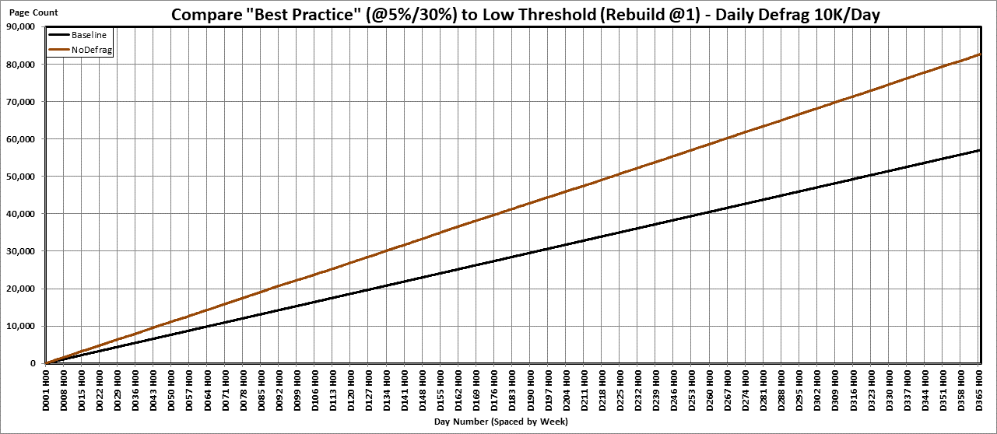
“No Index Maintenance” Line
“No Defrag” Facts
No Index Maintenance done
99.24% Fragmentation
68.24% Average Page Density
Constant Rate of BAD Page-Splits all day every day.
46.5%
Steeper Slope than Baseline
due to “Bad” Page-Splits
No Defrag
100%-------
68.24% Page Density
Actually wastes
46.5% more Memory.
(100/68.24-1)*100

Slide 47
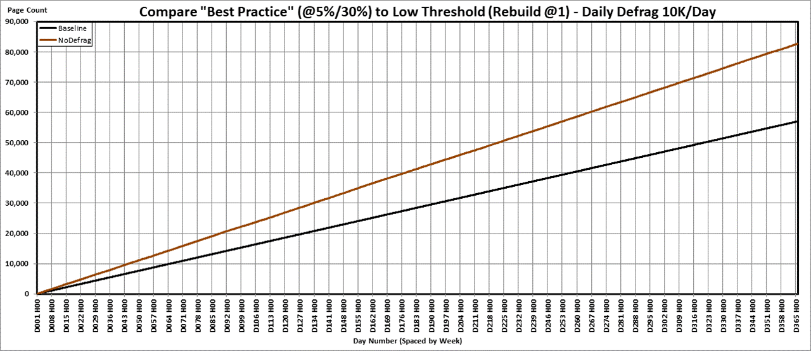
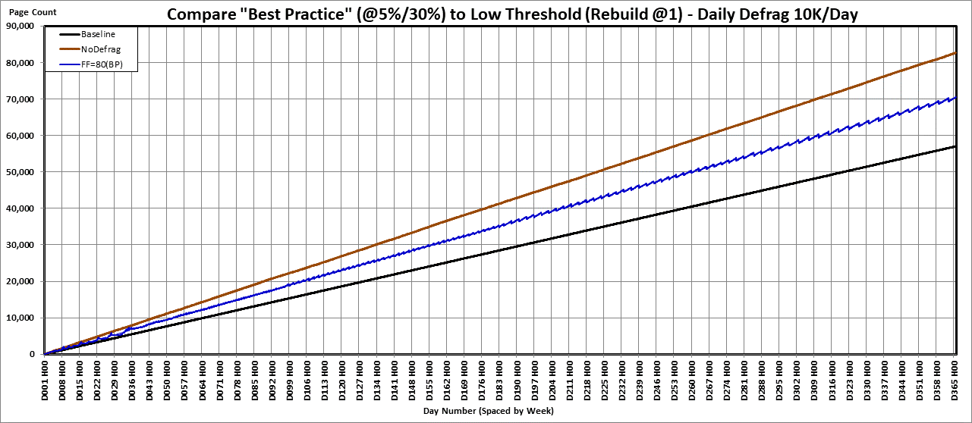
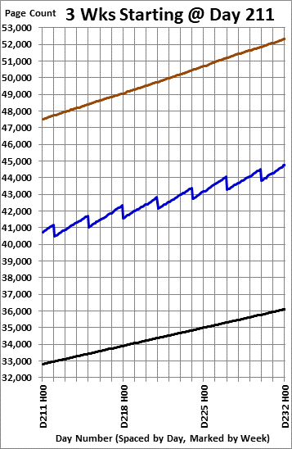
“Best Practice” with 80% Fill Factor
Page Splits Day 217 (10 Hrs)
No Defrag 261
Best Practice 451 Baseline 156
Riddled w/Page-Splits
All Day Every Day
Sudden drops due to
Reorganize
Removing Free Space
More Page Splits
Than No
Index Maintenance
Reminder!!!
That’s for just ONE INDEX!!!
Remember that lines
steeper than the
Baseline
Are due to “Bad”
Page- Splits!

Slide 48
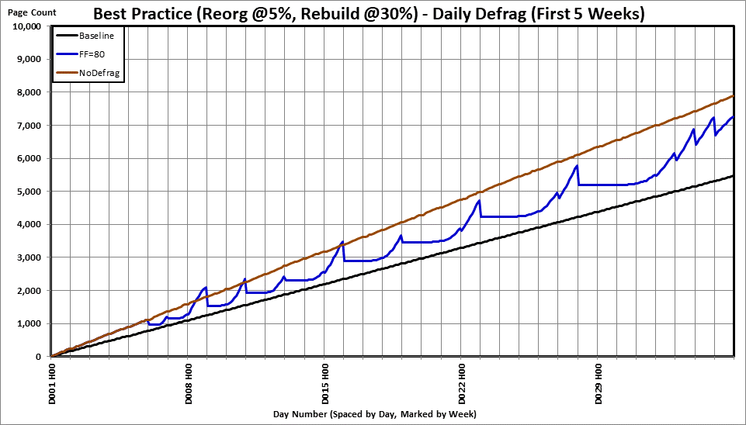
“Best Practice” with 80% Fill Factor
The “Flats” are where
NO PAGE-SPLITs
occur after a Rebuild!
Reorgs…
Everything else
Is a Rebuild.
Reorgs…
Very quickly
get “stuck”.
No Index
Maintenance
Until
1,000 Pages
First
5 weeks

Slide 49
“Best Practice” with 80% Fill Factor
Rebuild 130ms 50K Log Rows
Reorg Gets Stuck!
Page Splits ALL DAY EVERY DAY!
Reorg 310ms 272K Log Rows
Reorg 2617ms 237K Log Rows
Rebuild 227ms 49K Log Rows
293 11.5%
First
5 weeks
26 1%
0 Splits
0 Splits
22 1%
918 31.9%
142 7.4%
420 23.8%

Slide 50

“Best Practice” with 80% Fill Factor
How do we fix this?
Use LOW THRESHOLD REBUILDS
at 1% Fragmentation Instead!
Totally “PFM”!
Almost all page splits and fragmentation
disappear from our Random GUID Index!
REMEMBER WHAT THE “FLATS” ARE!!!
To Summarize:
REORGANIZE is the cause
and it’s dangerous!
It doesn’t work like most think.
Does NOTHING to prevent fragmentation.
It CAUSES page splits all day every day.
It is NOT a “Best Practice”!
We now know the reason why the
“Best Practice” line is jagged.
It’s Riddled w/Page-Splits
All Day Every Day
And, NOW WE KNOW THE CAUSE!

Slide 51
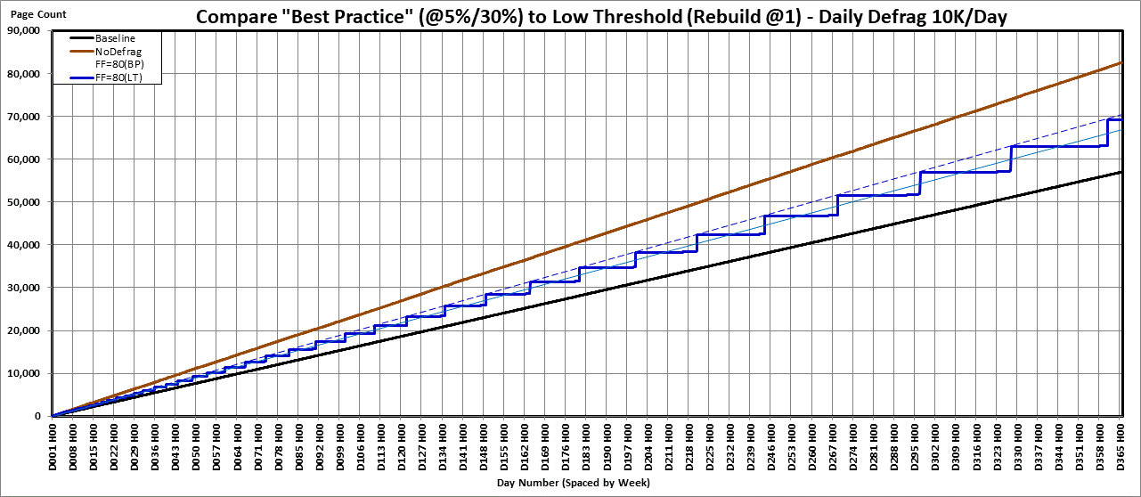
“Low Theshold” Rebuilds with 80% Fill Factor
Reorganize occurred
once every 3 days here
with DAILY Page-Splits
ZERO PAGE-SPLITs
for WEEKs at a time!
ZERO Maintenance
for WEEKs at a time!
3 days between
Rebuilds started
way back here.
End of run
Frag status?
1 Rebuild
a week
started here.
Except for when
Rebuild occurs,
ALWAYS uses
less memory!
1 Month (32 Days)
(32*10,000
= 320,000 Rows)
with <1% Frag
1 Rebuild in 3 WEEKS
with almost no
Page-Splits @<1% Frag

Slide 52
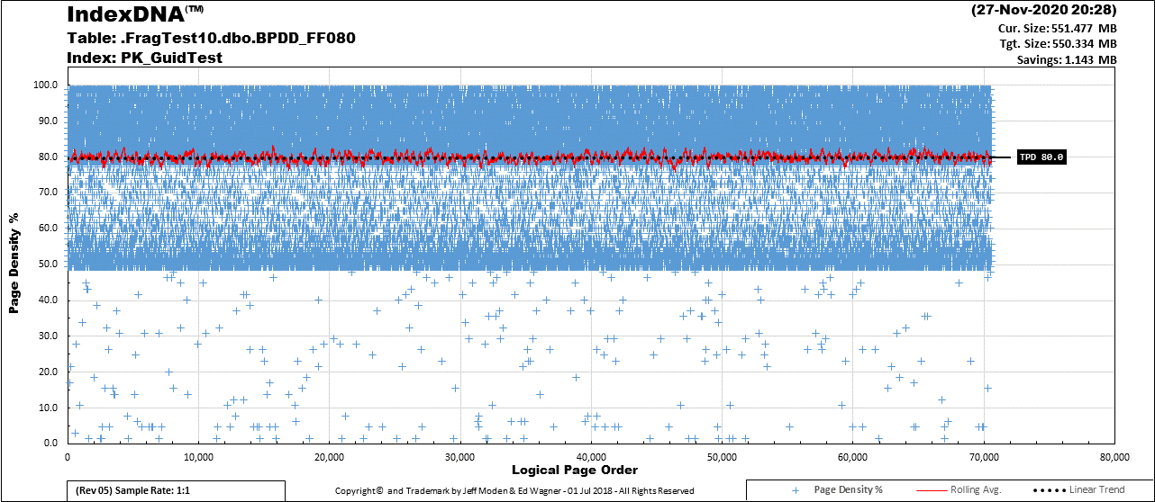
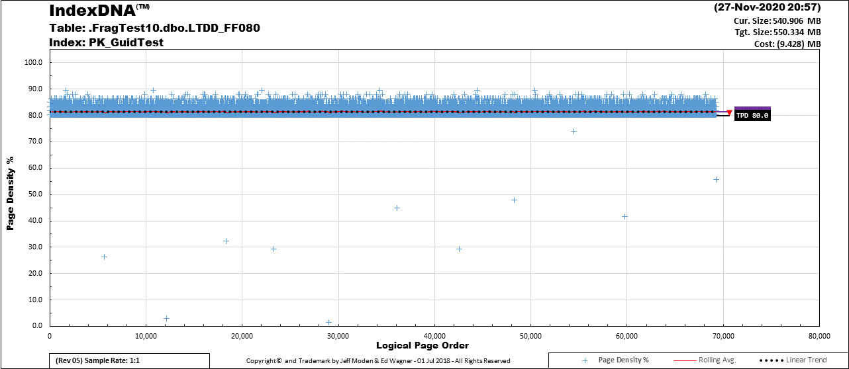
“Best Practice” v.s. “Low Theshold” IndexDNA™
Room to grow after 4 days no fragmentation
11
No Page-Splits after 4 days.
0.017% Fragmentation.
The few pages in this area are artifacts due to parallelism
during the REBUILD. There was no increase in page counts.
9
12
8
Looking at the area above the Fill Factor,
It’s easy to see why we have
continuous hourly Page-Splits…
There’s no room for INSERTs!
Reorganize CANNOT make pages!
6
10
1 Month (32 Days)
(32*10,000
= 320,000 Rows)
with <1% Frag
3
4
7
1
2
5

Slide 53
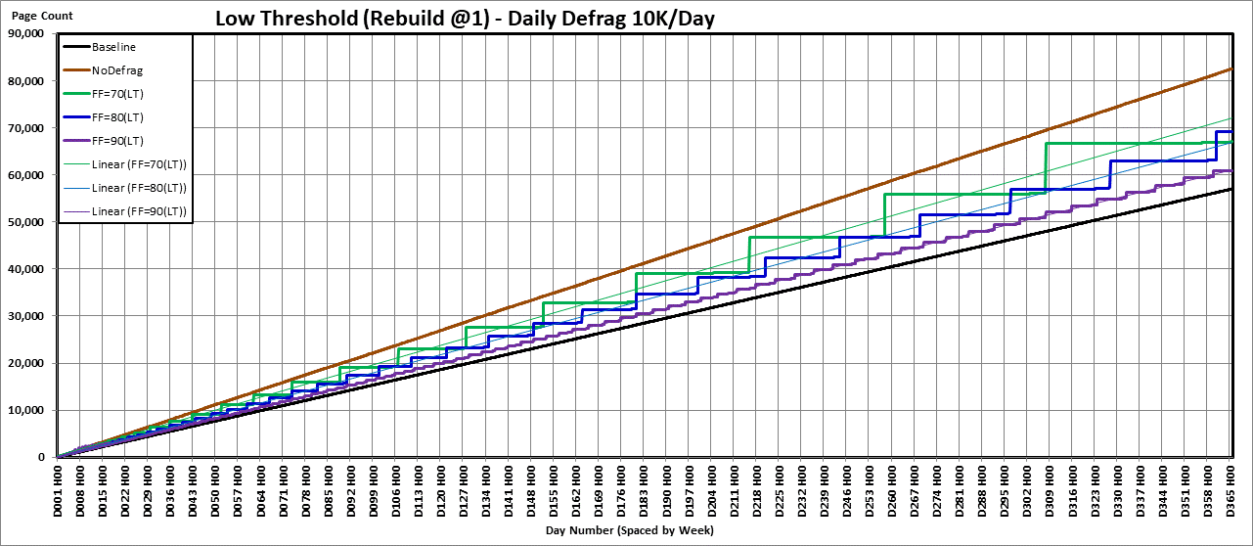
“Low Theshold” Rebuilds (70, 80, and 90% FF)
>8 Wks @ FF 70
<1% Frag
>8 Weeks (58 Days)
(58*10,000)
= 580,000 Rows)
@ 0.858% Frag
Legend
1 Month (32 Days)
(32*10,000) FF 80
= 320,000 Rows)
with <1% Frag
Just Before
a REBUILD.
The use of FF 90 for
1st year of GUID Indexes is NOT recommended.
Wait for another year.

Slide 54
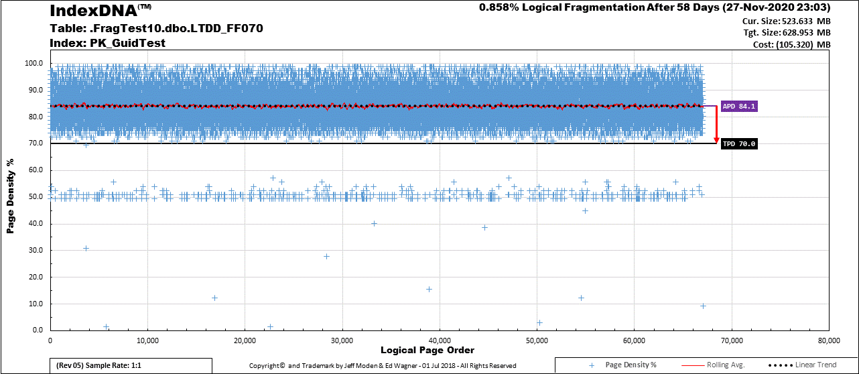
“Low Theshold” IndexDNA™ @70% FF 58 Days
Most of the area above the Fill Factor got used!
Very few page splits!
Using a FILL FACTOR to Prevent Fragmentation
is no worse than
Presizing a LOG File to Prevent Untimely Growth
~8 Weeks (58 Days)
(58*10,000
= 580,000 Rows)
@ 0.858% Frag

Slide 55
Log File Myths

Slide 56
Two Prevalent Myths
REORGANIZE always uses fewer resources than REBUILD.
REBUILD is always much worse for AG and other things that depend on the transaction log file.

Slide 57
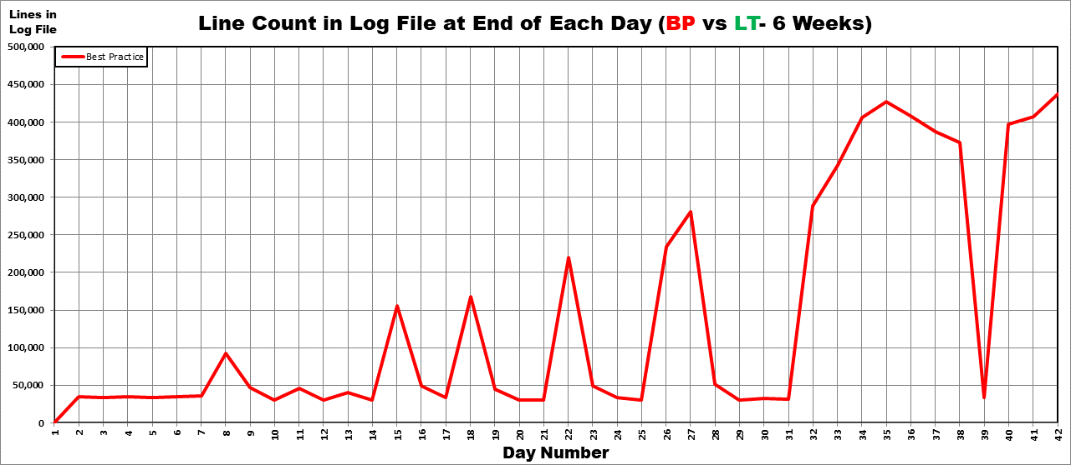
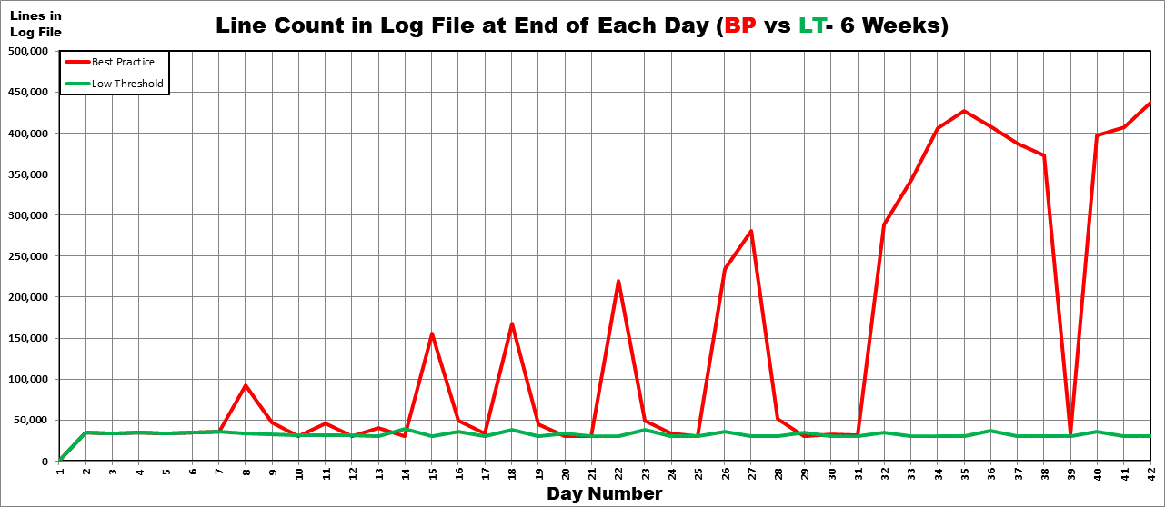
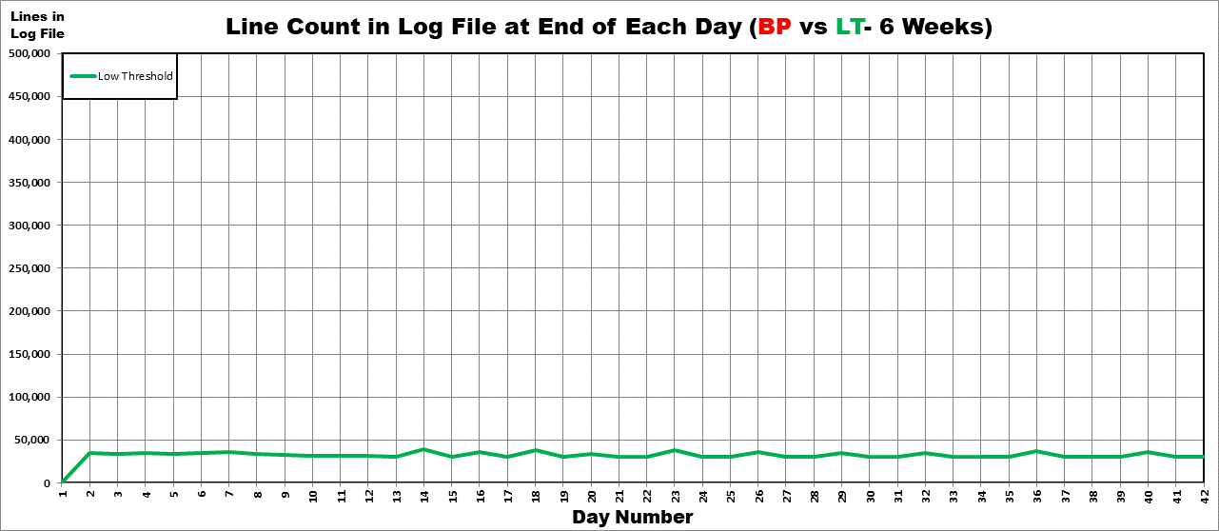
Log File Activity Comparison (6 Weeks) BULK LOGGED Recovery Model (80% Fill Factor)
“Best Practice” is NOT a Best Practice Here!
REORGANIZE MUST NOT BE USED HERE!
Remember, REORGANIZE PERPETUATED PAGE SPLITS, ALL DAY EVERY DAY!!!
Notice the “Flats” starting to form
after the REBUILDs
These spots are where REBUILDs Occurred.
All other humps are due to REORGANIZE.
Rebuilds > 1%
Every Day
Rebuilds > 1%
Rapidly Decrease in Frequency
This is how many log file rows are created just by the data each day. Its constant.
Number of daily rows in log file.
Reorgs cause a lot of
log file usage
compared to REBUILDs!
Number of Days

Slide 58
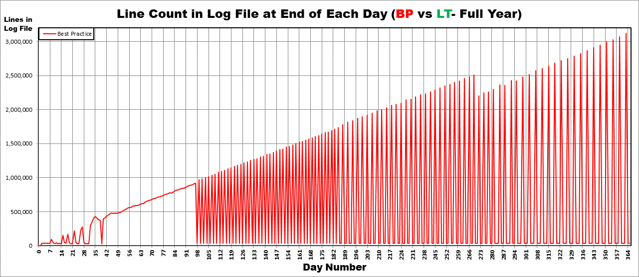
Log File Activity Comparison (Full Year) BULK LOGGED Recovery Model (80% Fill Factor)
More than 3 MILLION
Log File Entries for
EVERY REORG!
For just ONE INDEX!
REORGANIZE didn’t work!
REORG EVERY
3rd DAY!
REORG
EVERY
2nd DAY!
REORG
EVERY
DAY!
REORG EVERY
4th DAY!
First 6
Weeks

Slide 59
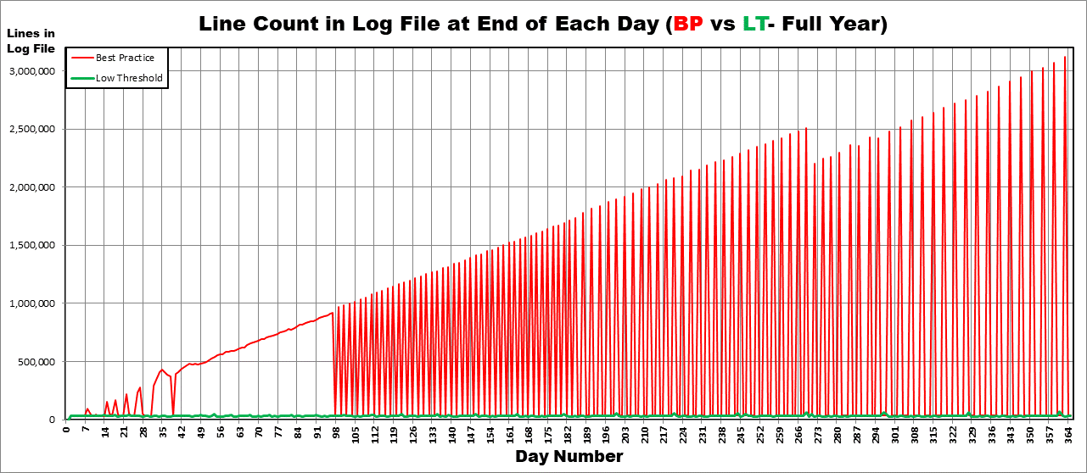
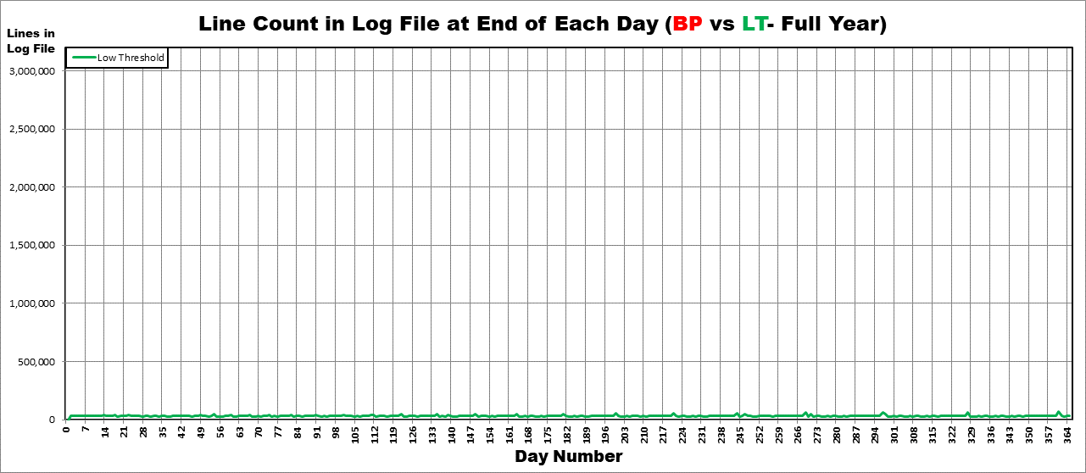
Log File Activity Comparison (Full Year) BULK LOGGED Recovery Model (80% Fill Factor)
This OFFLINE REBUILD
took 0.350 seconds and
62.9 Thousand Log File Entries
REBUILDs Are 2-5 WEEKS Apart!
Almost No Page Splits or Fragmentation!
<1% Fragmentation Except Day of REBUILD
And then still < 1.04% (80% Fill Factor)
REBUILD 1 to 2 Weeks
REBUILD
3 to 6
Days

Slide 60
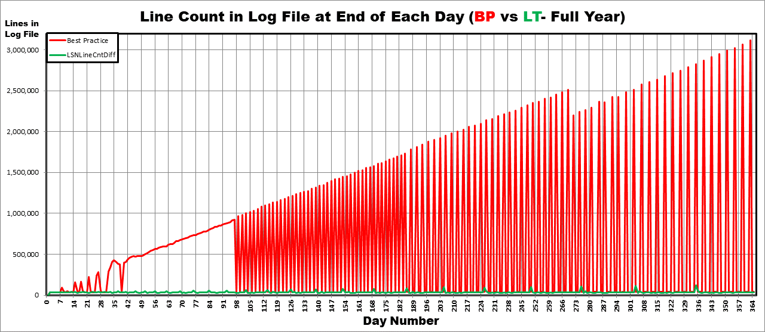
Log File Activity Comparison (Full Year) FULL Recovery Model (80% Fill Factor)
This OFFLINE REBUILD
took 0.990 seconds and
122.8 Thousand Log File Entries

Slide 61
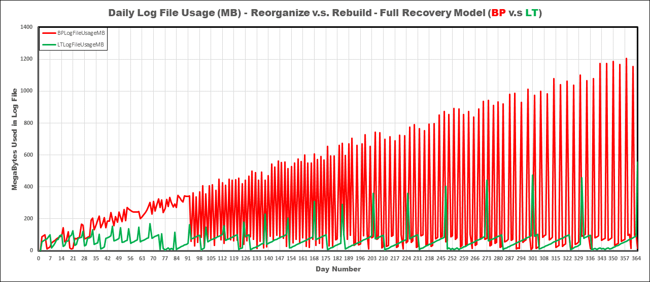
Log File Activity Comparison (Full Year) FULL Recovery Model (80% Fill Factor) (Space Used)
REORGANIZE Also Uses A LOT MORE Logfile Space!
Less Resource Intensive?

Slide 62
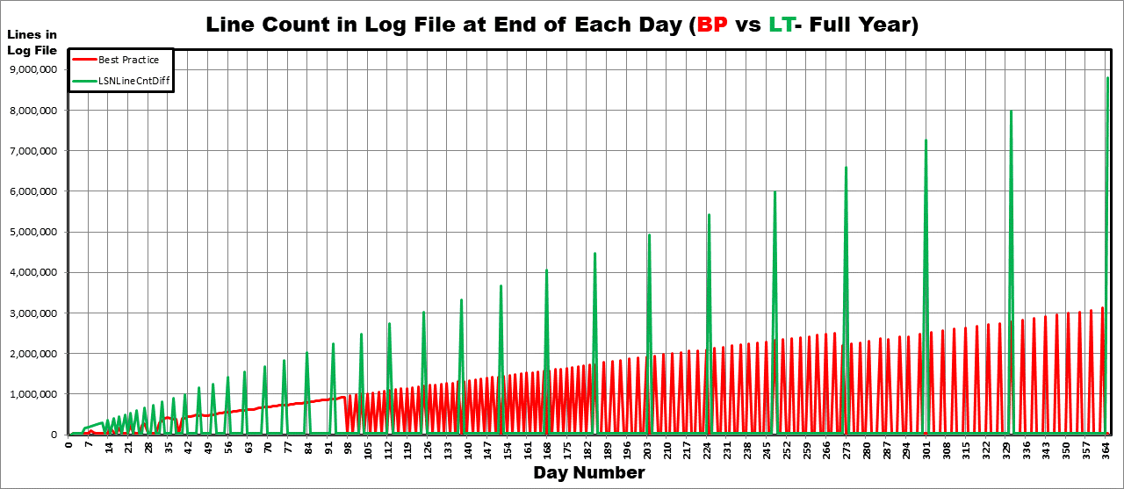
Log File Activity Comparison (Full Year) FULL Recovery Model w/ ONLINE REBUILDS (80%)
This ONLINE REBUILD took 8.806 seconds
and almost 8 million log file entries.
THE REBUILDS WENT A MONTH WITH ALMOST NO PAGE SPLITS,
< 1% FRAGMENTATION,
AND NO INDEX MAINTENANCE!!!
The REORGs between these two REBUILDS
took 65.554 seconds (avg 8.194) and
22.7 million log file entries (avg 2.8 million),
RAN EVERY 4 DAYS,
AND PERPETUATED PAGE SPLITS ALL DAY, EVERY DAY!
AND THAT’S ON JUST ONE SMALL INDEX!

Slide 63
Recommendation In Order by Performance.
If you can, use BULK LOGGED OFFLINE Rebuilds.
If you can’t, use FULL Recovery Model OFFLINE Rebuilds.
If you can’t, use FULL Recovery Model ONLINE Rebuilds.
Whatever you do…
DON’T USE REORGANIZE ON RANDOM GUIDS!
It’s better to not do any index maintenance than it is to do it wrong and using Reorganize is doing it WRONG!
Exception for GUIDs:
Use REORGANIZE only to compact LOBs.
Then do a REBUILD immediately after!
LOBs are a whole other session.
Other Indexes:
DON’T use REORGANIZE on an index that needs to grow in order to clear the area above the Fill Factor (not just GUIDs).
OK (kind of) for “End-of-Index” “ExpAnsive Updates”.

Slide 64
NEWSEQUENTIALID()
Solves Everything about GUID Fragmentation
“Best Practices” says so… RIGHT???

Slide 65
“Features” of NEWSEQUENTIALID()
Similar to old Type 1 GUIDs.
It’s a security risk - Contains MAC Address!
Other Issues
Changes sequence at every restart (ahead or possibly behind).
Not contiguous… Jumps ahead every 10,000 values.
ONLY works as a column default!
Still requires 2nd trip to get latest value.
Still has a “Hot Spot” (just like IDENTITY)!
Everyone still waits for 1 page during Inserts.
Supposed “good” page splits still take time.
Supposed “good” page splits still cause blocking.
System still has to wait on sequential generation.
Slows down concurrent Inserts.
Massive Splitting due to “ExpAnsive Updates”.
Still, it IS the best for Merges
Can help prevent some NCI splits.

Slide 66
Summary/Recommendation:
NEWSEQUENTIALID() same size as Random GUIDs.
Considered “Globally Unique” because of MAC Address.
Much better than IDENTITY.
Except for merges…
Has all the same index disadvantages of IDENTITY.
Has NONE of the index advantages of Random GUIDs.
Still, it DOES help prevent NCI page splits.
Has many of it’s own disadvantages.
IT’S A SECURITY RISK if public facing.
It’s not contiguous sequential.
Recommendation:
Only use for guaranteed collision-free merges.

Slide 67
Intro to “ExpAnsive Updates”
Massive Splitting Headache!

Slide 68
Lowering the Fill Factor
Conventional "wisdom“…
If fragmentation occurs, lower the Fill Factor.
Ooooohhhh yeeeeaaahhh!
Lets see how "well" that works for…
IDENTITY Clustered Indexes
Insert/ExpAnsive Update Pattern (Type 97)

Slide 69
Definition of “ExpAnsive Update”
Anything that causes a row to grow in size.
Applies to all in-row variable width columns.
Classic Examples
Modified_By column
VARCHAR()
Goes from NULL to something.
Status column
VARCHAR()
Goes from “Pending” (7 chars) to “Completed” (9 chars).
Hidden Example
Out-of-Row LOBs (covered in another session).
The “pointer” column is “ExpAnsive”.
Row Compressed Numbers and other “fixed size” datatypes.
Especially NULL to something bigger than 1 byte.

Slide 70
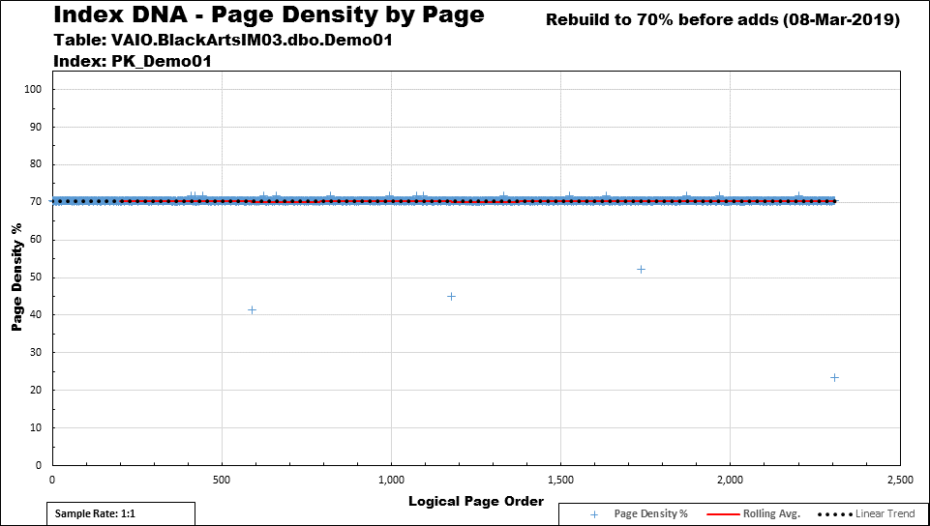
Ever-Increasing IDENTITY Clustered Index
Table contains 90,000 rows
Common Processing Method
Insert New Rows (they go in at the end of the index).
Process those newly inserted Rows.
Update the New Rows as “Processed”.
“Comments and “Modified_By” is a common mistake.
Fragmentation occurs.
Lower Fill Factor to try to stop it.
This is how much space it takes now.
An extra 660+ pages!
About 40% MORE!!!
This is how much space it used to take.
~1640 pages.

Slide 71
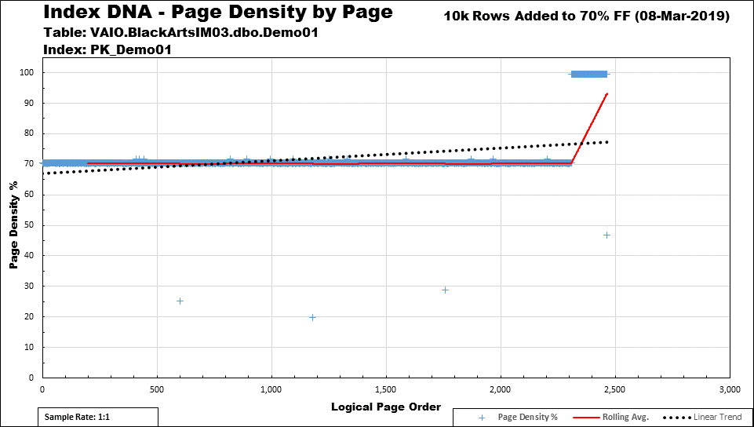
“Append Only” Inserts ALWAYS Fill to 100%
New rows filled to almost 100% despite the Fill Factor.
It ALWAYS happens on "Append Only" Index INSERTs.
Let's see what happens when we insert 10,000 rows

Slide 72
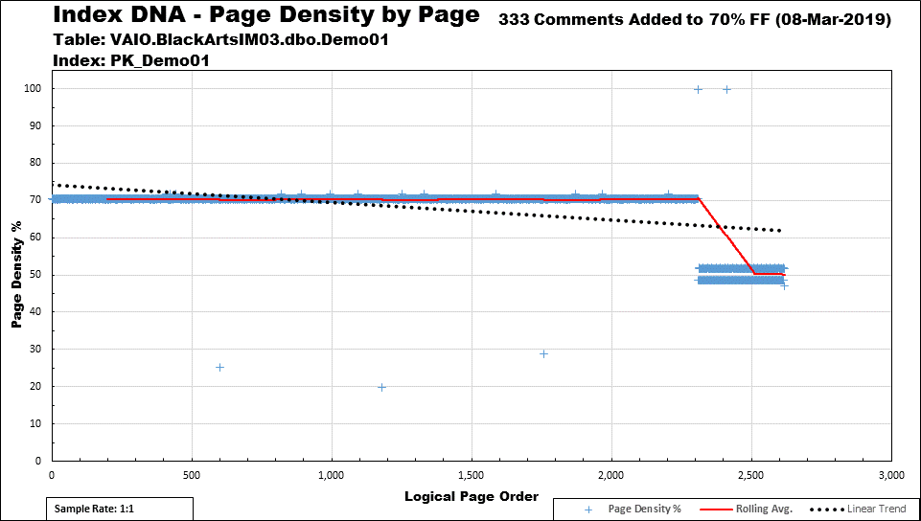

The Devastating Effect of “ExpAnsive Updates”
And guess what?
NEWSEQUENTIALID()
has the SAME problem!
The seriously reduced Fill Factor did NOTHING to prevent fragmentation even with just 333 updates!
It IS, however, wasting all this (about 40% if you do the math) memory/disk space!
To Summarize
The IDENTITY column index is WASTING HALF THE MEMORY ON THE MOST ACTIVE SECTION OF THE INDEX (SELECTs Take 2X to Run!)
due to massive fragmentation that won’t be fixed until the next Index Maintenance run!
On top of every thing else that's wrong, our index scans now take 40% LONGER!
A properly built and maintained Random GUID index
would NOT have fragmented.
(Already proven)
And people say that Random GUIDs have a fragmentation problem???
Now, ask yourself…
What data will most queries concentrate on?
The answer is
ON THE MOST RECENTLY
ADDED DATA!
Now, let’s update Modified_By (or Comments) on just 333 of the 10K rows.

Slide 73
OPTIMIZE_FOR_SEQUENTIAL_KEY
SQL Server 2019 (“Fix” for the “Hot Spot”)
It doesn’t fix the “ExpAnsive” Update Problem.
A type of insert throttling/scheduling (my words).
Pam Lahoud (Microsoft)
https://techcommunity.microsoft.com/t5/sql-server/behind-the-scenes-on-optimize-for-sequential-key/ba-p/806888
A better fix is frequently recommended…
https://docs.microsoft.com/en-US/troubleshoot/sql/performance/resolve-pagelatch-ex-contention
4 of the 6 methods recommend changing to non-sequential index keys.
Guess what “Method 4” recommends?...

Slide 74
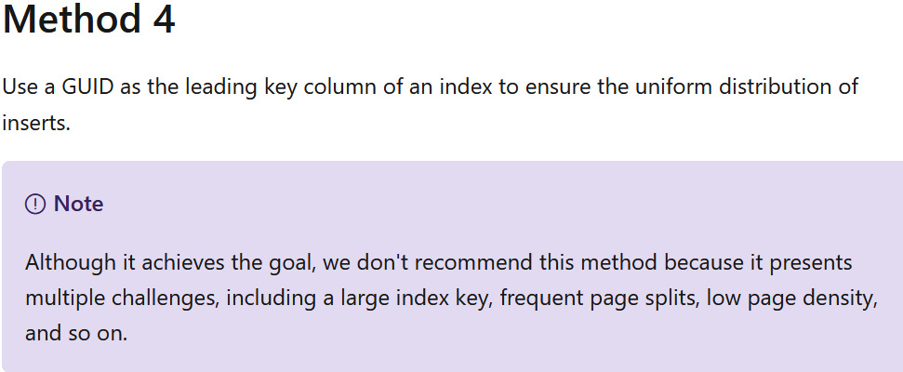
SURPRISE!!!
It will also fix the “ExpAnsive” update problem!
BUSTED!

Slide 75
Review

Slide 76
IDENTITY
Has Issues
“Hot Spot” at end of index
Page contention
Everyone waits their turn
Not good for Merges
Not good for Replication
Very Prone to extreme fragmentation during Insert/Update pattern due to “ExpAnsive Updates”
Non-Clustered Indexes are NOT immune from fragmentation.
Needs two trips to Insert and then get the new key.
Frequently not the best Clustered Index for performance.
Good Things?
Narrow compared to GUIDs
Follows “Best Practice” of being “Ever-Increasing”
Low overhead in Non-Clustered Indexes
Recommendation
Ok to use and don’t need to change but can have serious problems.
There are other “fixes” we cover in other sessions.

Slide 77
NEWSEQUENTIALID()
Has issues
All the same index problems as IDENTITY except for…
Virtually no chance of collisions during merges.
Great for replication.
Security risk because of MAC address.
They’re BIG. Uses same space as Random GUIDs.
None of the index advantages of Random GUIDs.
Recommendation
That’s up to the requirements… and you.
Best for guaranteed collision-free merges/replication.

Slide 78
Random GUIDs
Have Issues
They’re freakin’ HUGE!
Causes similar overhead in Non-Clustered Indexes.
Collisions still possible although astronomically rare.
Clustered Index can cause splits in non-clustered indexes
BUT So do a lot of other things!
Still, might be worth it (as we’ve seen/proven)
Massive Fragmentation?
Inserts
“ExpAnsive Updates”
BUSTED BIGTIME!

Slide 79
Random GUIDs
Good Things
Epitome of how we think an index should work.
No “Hot Spot”.
No contention waiting on single page and no “Insert Throttling”..
Fill Factor is actually useful.
Weathers “ExpAnsive Updates”
Can go weeks and months with NO PAGE SPLITS or FRAGMENTATION.
Good for Merges
Good for Replication

Slide 80
…and More
No second trip to get value.
No central authority required to…
Issue values
Prevent dupes
No special handling needed for simultaneous entries.
No waiting on IDENTITY generation.
Heh… and did I mention that there’s virtually …
… for weeks and even months!
NO FRAGMENTATION!

Slide 81
We Learned “The Secrets” for Random GUIDs…
Use a lower Fill Factor of 71 or 81.
The “1” is to remind you to REBUILD at > 1%
NEVER USE
REORGANIZE
TO MAINTAIN
RANDOM GUID
INDEXES

Slide 82
REORGANIZE
Compresses Indexes
Removes free space below the Fill Factor
Cannot add space above the Fill Factor
Never use for general defrag of Random GUIDs.
Think about it…
What causes fragmentation and low page density?
Out of order inserts and “ExpAnsive” updates.
Think about it again!
Are Random GUIDs the only things that fragment?
Recommendation:
Don’t use REORGANIZE except to...
Compress LOBs (do a REBUILD right after that).
(Maybe) Repair end-of-index “ExpAnsive Updates”.

Slide 83
Other Things to Remember
Learn how to use Clustered Indexes correctly.
The PK doesn’t always need to be the Clustered Index.
“It Depends”!
Learn how to use a Fill Factor correctly.
Learn what your big indexes are actually doing…
Especially your “Ever Increasing” indexes!
Hint: If you’re doing index maintenance on 0/100 Fill Factors that fragment on a regular basis…
THEN YOU’RE PERPETUATING MASSIVE PAGE SPLITS AND FRAGMENTATION (in one way or another)!
(Covered in other sessions)

Slide 84
Other Things to Remember…
Not doing index maintenance is better than doing it wrong BUT, in the long term…
Not doing index maintenance is still really bad.
Don’t forget! It helps minimize page splits!
Find out what’s wrong and FIX IT!
Be religious about rebuilding Statistics!

Slide 85
GUIDs v.s. Fragmentation
Random GUIDs are NOT the problem… We are!
If you’re using the current world-wide accepted “Best Practice” Index Maintenance…
… Then, you’re probably doing it wrong.
(not limited to but especially for GUIDs)
GUID Fragmentation is a myth perpetuated by...
Bad demonstrations.
Misinformation.
We used Random GUIDs to prevent fragmentation during “ExpAnsive” Updates.

Slide 86
Q
‘
N
‘
A

Slide 87
Great Question…
During the presentation, we used an example that inserted 10K rows per day.
What happens if we seriously increase the normal number of rows inserted per day?
Answer…
It’s totally self-scaling!
Pure Proportional Mathematical Magic!
Let’s have a look!

Slide 88
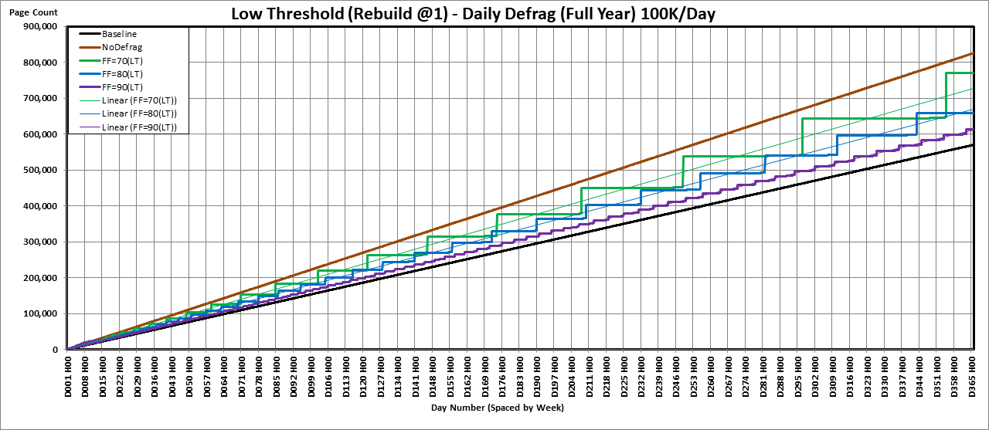
Ratio Stays the ~Same for ANY CONSISTENT Insert Rate
>8 Weeks (58 Days)
(58*100,000)
= 5,800,000 Rows)
with <1% Frag
Does anyone in the room still think that Random GUIDs are a
FRAGMENTATION PROBLEM???
1 Month (32 Days)
(32*100,000)
= 3,200,000 Rows)
with <1% Frag

Slide 89
“Black Arts” Index Maintenance #1.2
GUIDs v.s. Fragmentation
They're not the problem... WE ARE!
By Jeff Moden
Thank you for listening. Thank you for what you do!

